Slide 1
Chapter 17
Methodology
Logical Database Design for the Relational Model
Pearson Education © 2009

Slide 2
Chapter 17 - Objectives
How to derive a set of relations from a conceptual data model.
How to validate these relations using the technique of normalization.
Pearson Education © 2009

Slide 3
Chapter 17 - Objectives
How to validate a logical data model to ensure it supports the required transactions.
How to merge local logical data models based on one or more user views into a global logical data model that represents all user views.
How to ensure that the final logical data model is a true and accurate representation of the data requirements of the enterprise.
Pearson Education © 2009

Slide 4
Step 2 Build and Validate Logical Data Model
To translate the conceptual data model into a logical data model and then to validate this model to check that it is structurally correct using normalization and supports the required transactions.
Pearson Education © 2009

Slide 5
Step 2 Build and Validate Logical Data Model
Step 2.1 Derive relations for logical data model
To create relations for the logical data model to represent the entities, relationships, and attributes that have been identified.
Pearson Education © 2009

Slide 6
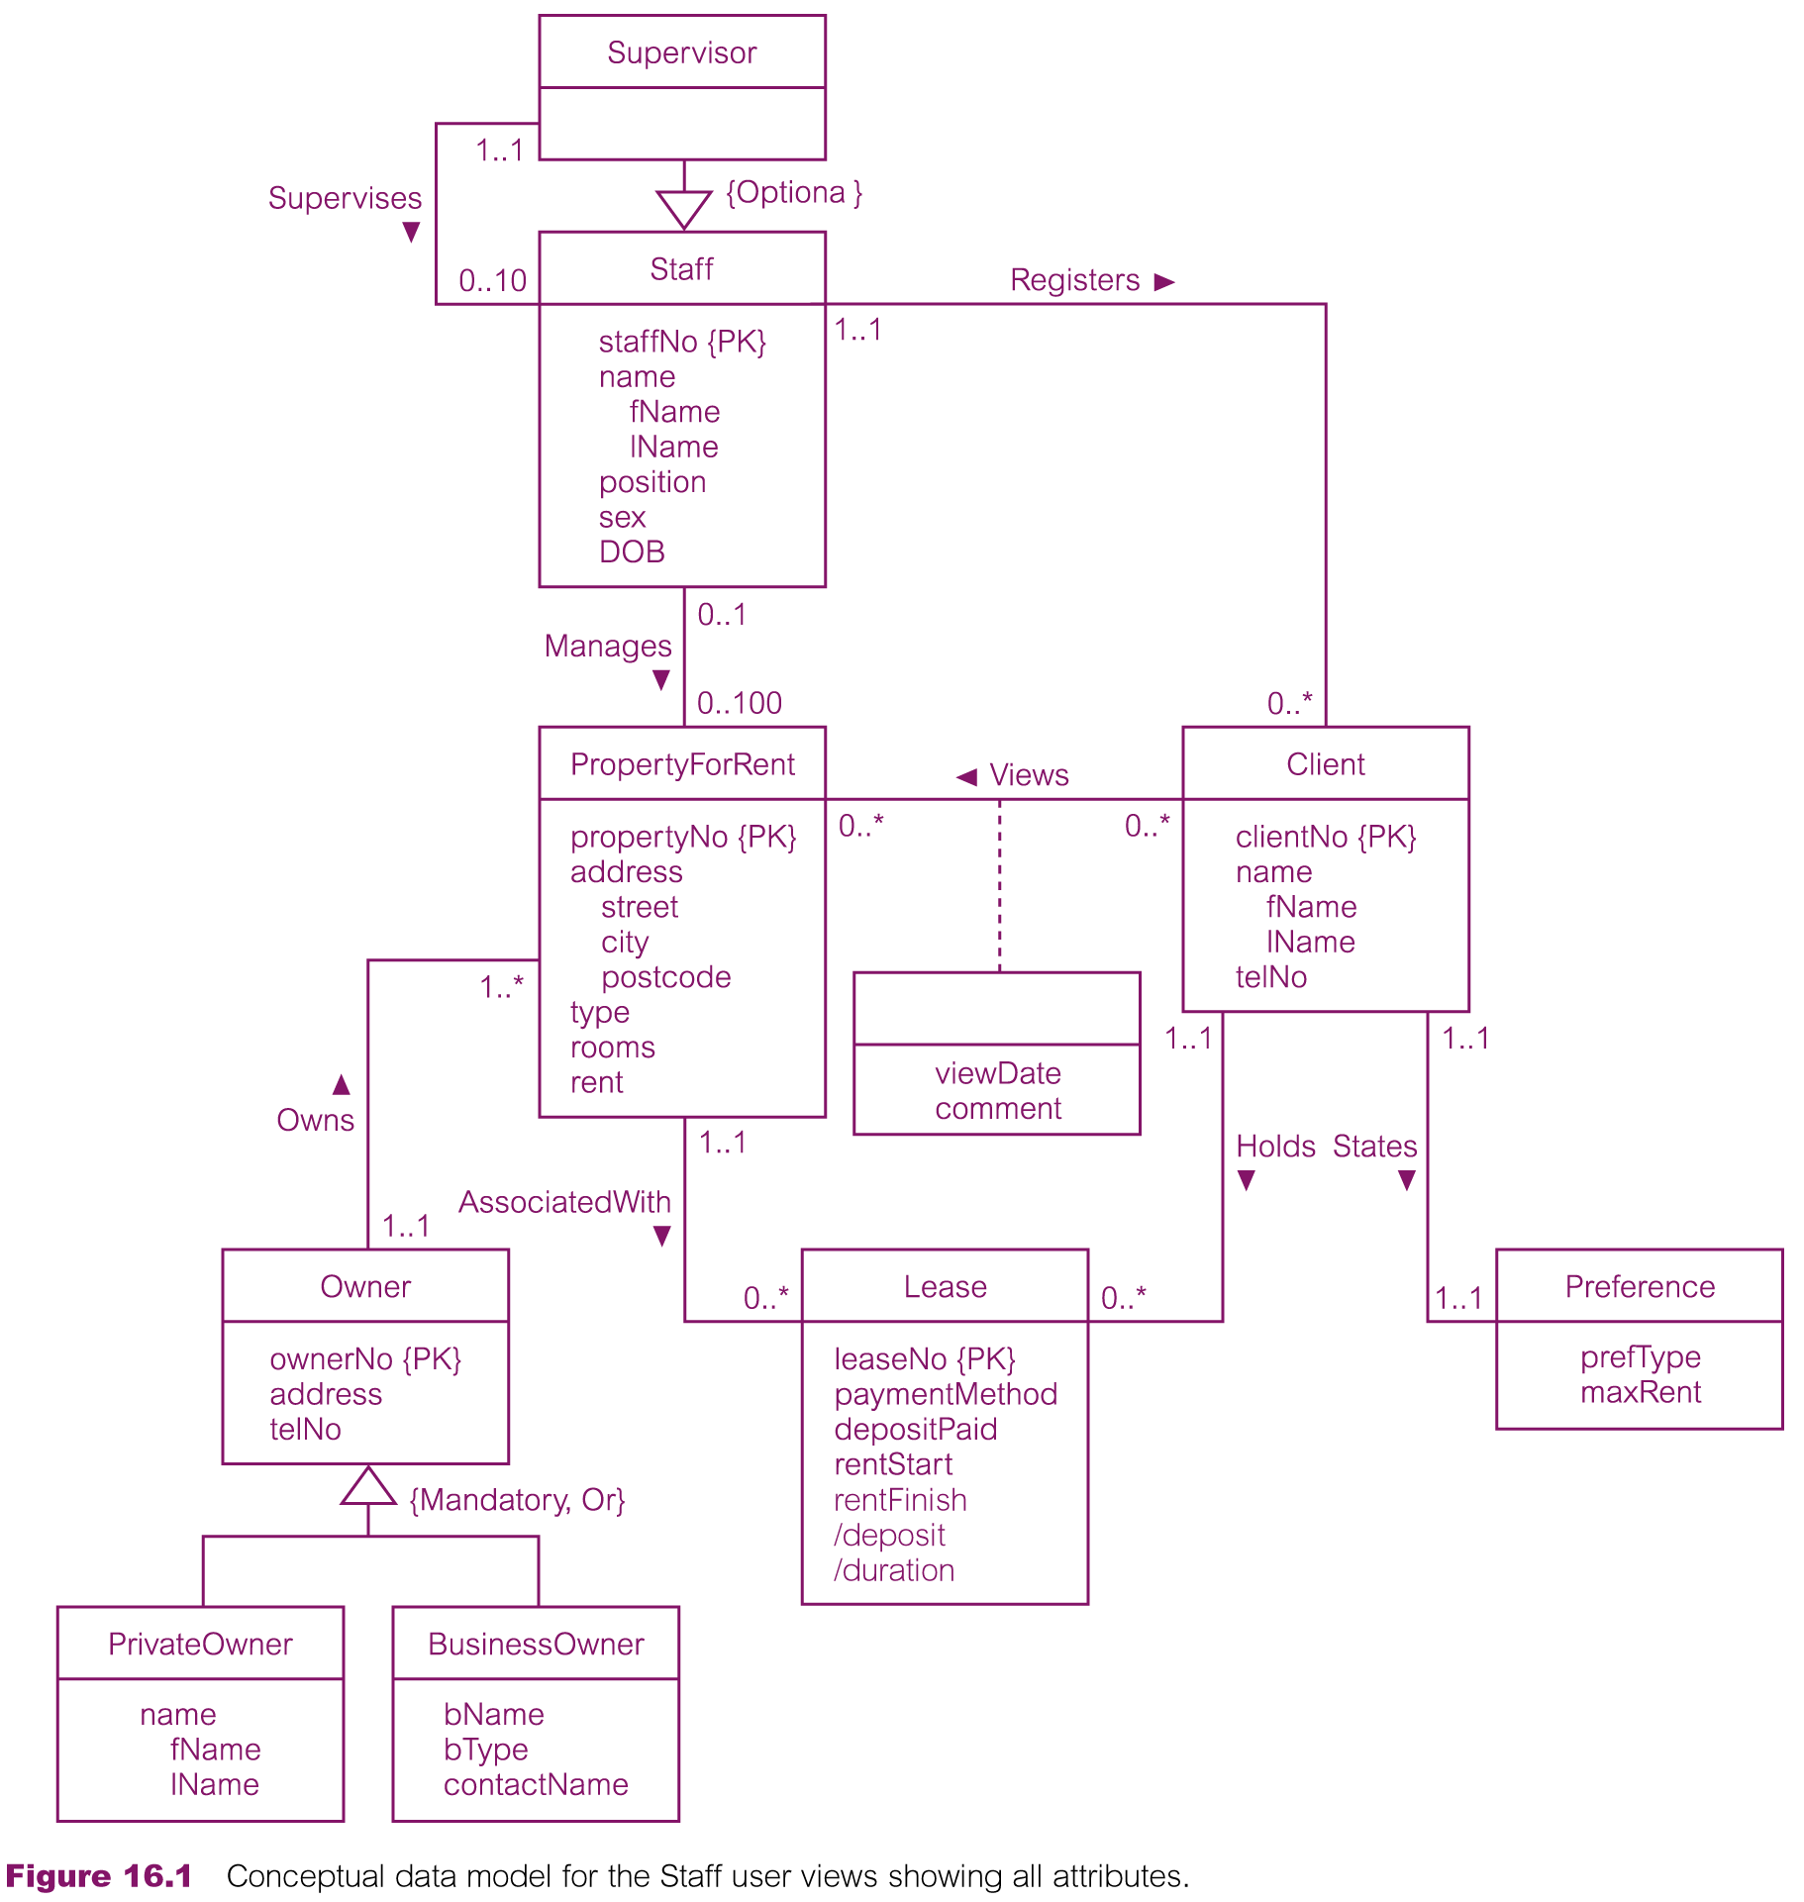
Conceptual data model for Staff view showing all attributes
Pearson Education © 2009

Slide 7
Step 2.1 Derive relations for logical data model
(1) Strong entity types
For each strong entity in the data model, create a relation that includes all the simple attributes of that entity. For composite attributes, include only the constituent simple attributes.
Weak entity types
For each weak entity in the data model, create a relation that includes all the simple attributes of that entity. The primary key of a weak entity is partially or fully derived from each owner entity and so the identification of the primary key of a weak entity cannot be made until after all the relationships with the owner entities have been mapped.
Pearson Education © 2009

Slide 8
Step 2.1 Derive relations for logical data model
(3) One-to-many (1:*) binary relationship types
For each 1:* binary relationship, the entity on the ‘one side’ of the relationship is designated as the parent entity and the entity on the ‘many side’ is designated as the child entity. To represent this relationship, post a copy of the primary key attribute(s) of parent entity into the relation representing the child entity, to act as a foreign key.
Pearson Education © 2009

Slide 9
Step 2.1 Derive relations for logical data model
(4) One-to-one (1:1) binary relationship types
Creating relations to represent a 1:1 relationship is more complex as the cardinality cannot be used to identify the parent and child entities in a relationship. Instead, the participation constraints are used to decide whether it is best to represent the relationship by combining the entities involved into one relation or by creating two relations and posting a copy of the primary key from one relation to the other.
Consider the following
(a) mandatory participation on both sides of 1:1 relationship;
(b) mandatory participation on one side of 1:1 relationship;
(c) optional participation on both sides of 1:1 relationship.
Pearson Education © 2009

Slide 10
Step 2.1 Derive relations for logical data model
(a) Mandatory participation on both sides of 1:1 relationship
Combine entities involved into one relation and choose one of the primary keys of original entities to be primary key of the new relation, while the other (if one exists) is used as an alternate key.
(b) Mandatory participation on one side of a 1:1 relationship
Identify parent and child entities using participation constraints. Entity with optional participation in relationship is designated as parent entity, and entity with mandatory participation is designated as child entity. A copy of primary key of the parent entity is placed in the relation representing the child entity. If the relationship has one or more attributes, these attributes should follow the posting of the primary key to the child relation.
Pearson Education © 2009

Slide 11
Step 2.1 Derive relations for logical data model
(c) Optional participation on both sides of a 1:1 relationship
In this case, the designation of the parent and child entities is arbitrary unless we can find out more about the relationship that can help a decision to be made one way or the other.
Pearson Education © 2009

Slide 12
Step 2.1 Derive relations for logical data model
(5) One-to-one (1:1) recursive relationships
For a 1:1 recursive relationship, follow the rules for participation as described above for a 1:1 relationship.
mandatory participation on both sides, represent the recursive relationship as a single relation with two copies of the primary key.
mandatory participation on only one side, option to create a single relation with two copies of the primary key, or to create a new relation to represent the relationship. The new relation would only have two attributes, both copies of the primary key. As before, the copies of the primary keys act as foreign keys and have to be renamed to indicate the purpose of each in the relation.
optional participation on both sides, again create a new relation as described above.
Pearson Education © 2009

Slide 13
Step 2.1 Derive relations for logical data model
(6) Superclass/subclass relationship types
Identify superclass entity as parent entity and subclass entity as the child entity. There are various options on how to represent such a relationship as one or more relations.
The selection of the most appropriate option is dependent on a number of factors such as the disjointness and participation constraints on the superclass/subclass relationship, whether the subclasses are involved in distinct relationships, and the number of participants in the superclass/subclass relationship.
Pearson Education © 2009

Slide 14
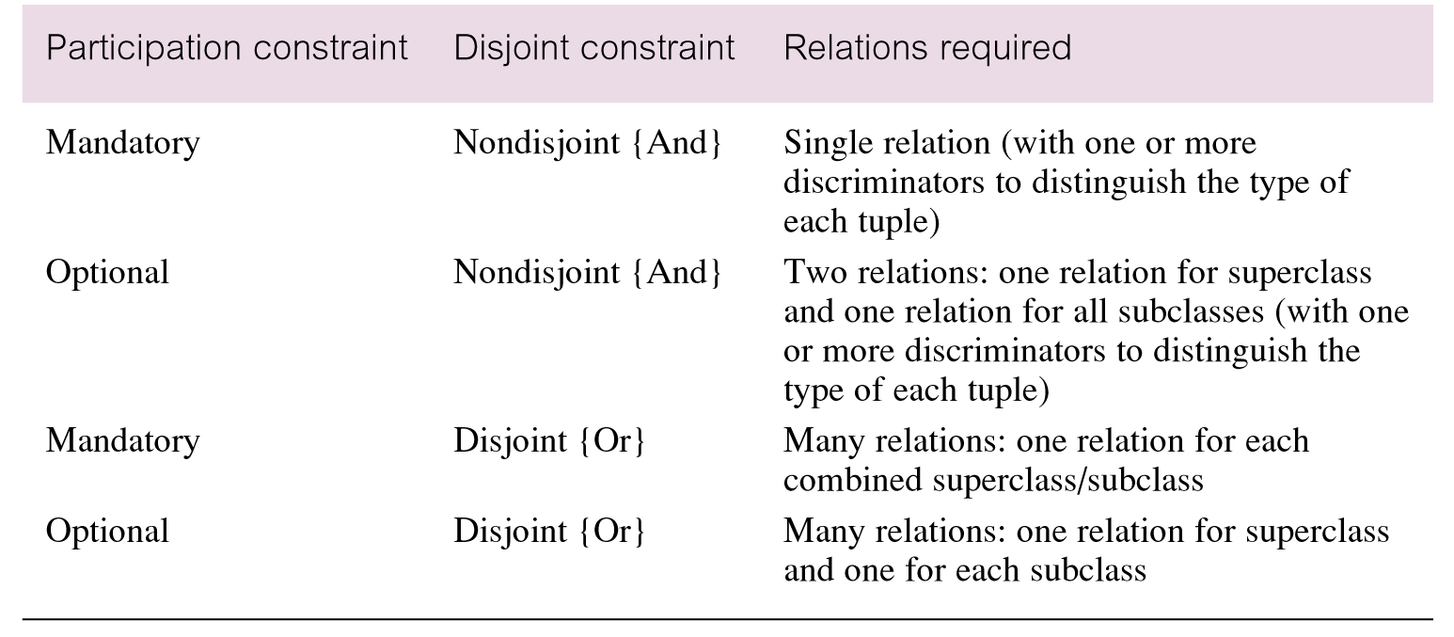
Guidelines for representation of superclass / subclass relationship
Pearson Education © 2009

Slide 15
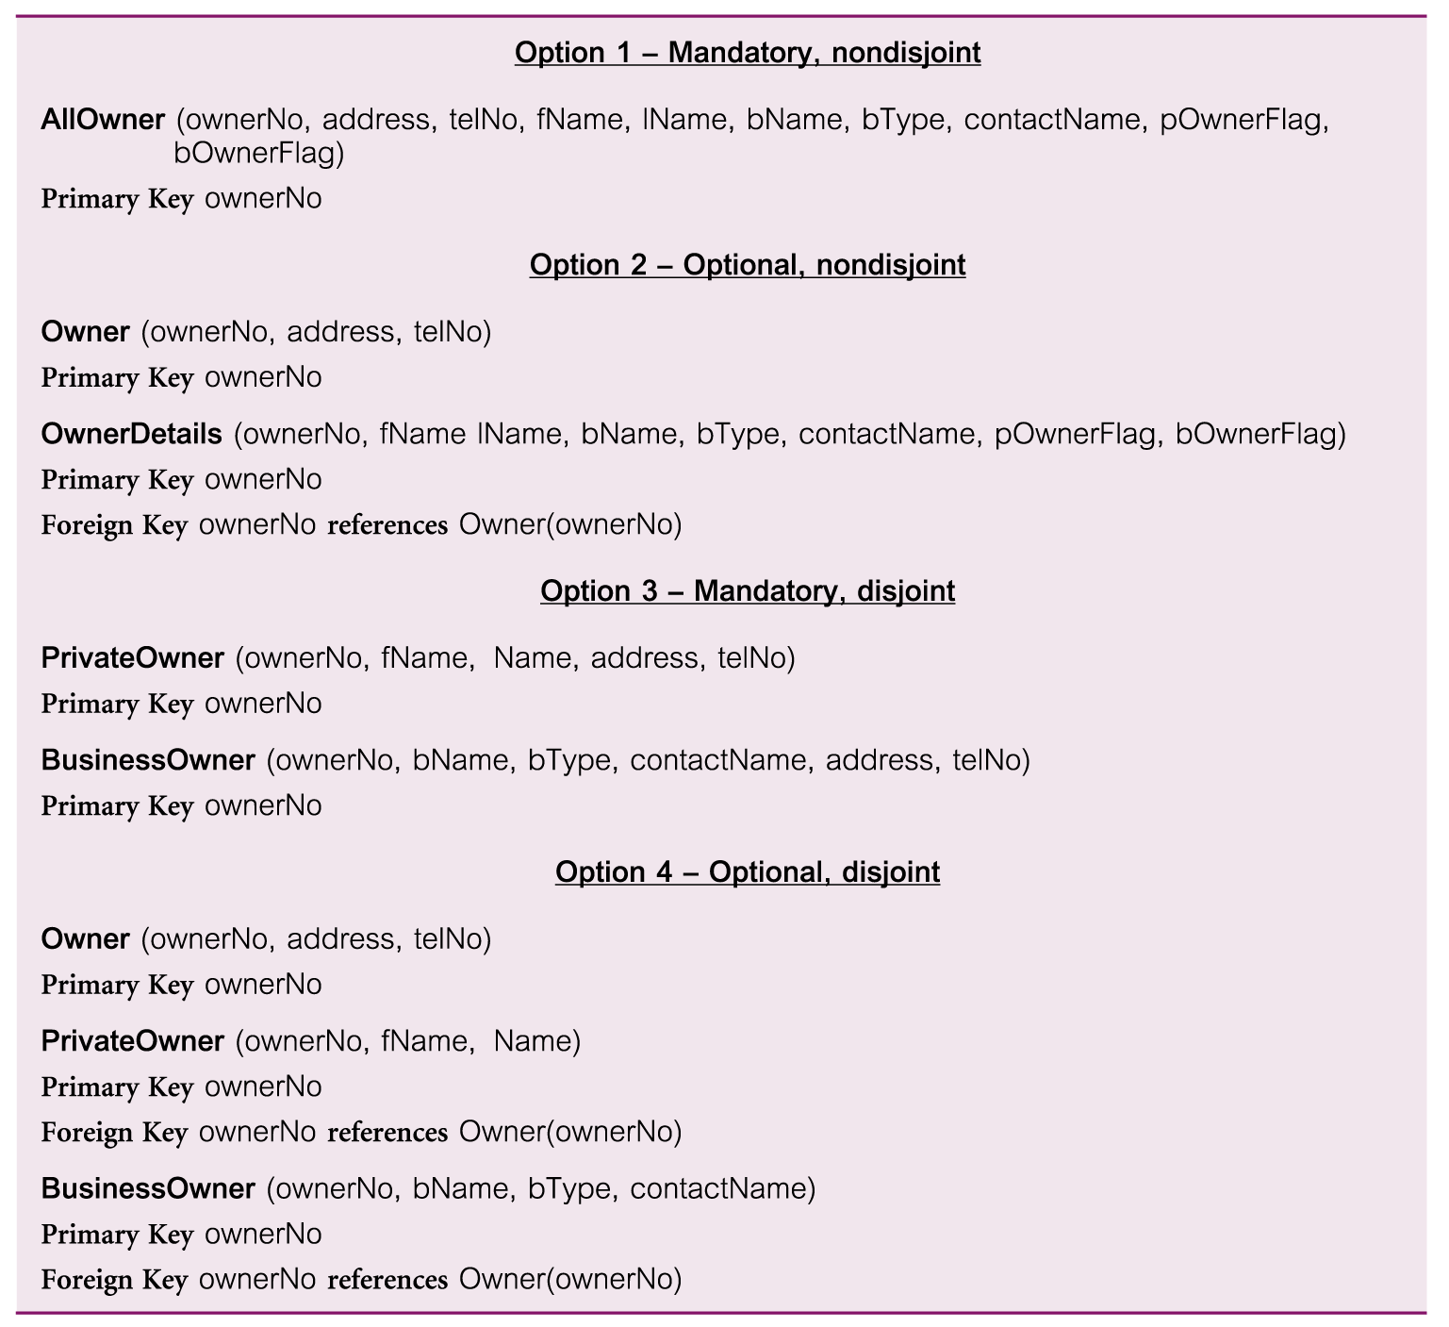
Representation of superclass / subclass relationship based on participation and disjointness
Pearson Education © 2009

Slide 16
Step 2.1 Derive relations for logical data model
(7) Many-to-many (*:*) binary relationship types
Create a relation to represent the relationship and include any attributes that are part of the relationship. We post a copy of the primary key attribute(s) of the entities that participate in the relationship into the new relation, to act as foreign keys. These foreign keys will also form the primary key of the new relation, possibly in combination with some of the attributes of the relationship.
Pearson Education © 2009

Slide 17
Step 2.1 Derive relations for logical data model
(8) Complex relationship types (degree > 2)
Create a relation to represent the relationship and include any attributes that are part of the relationship. Post a copy of the primary key attribute(s) of the entities that participate in the complex relationship into the new relation, to act as foreign keys. Any foreign keys that represent a ‘many’ relationship (for example, 1..*, 0..*) generally will also form the primary key of this new relation, possibly in combination with some of the attributes of the relationship.
Pearson Education © 2009

Slide 18
Step 2.1 Derive relations for logical data model
(9) Multi-valued attributes
Create a new relation to represent multi-valued attribute and include primary key of entity in new relation, to act as a foreign key. Unless the multi-valued attribute is itself an alternate key of the entity, the primary key of the new relation is the combination of the multi-valued attribute and the primary key of the entity.
Pearson Education © 2009

Slide 19
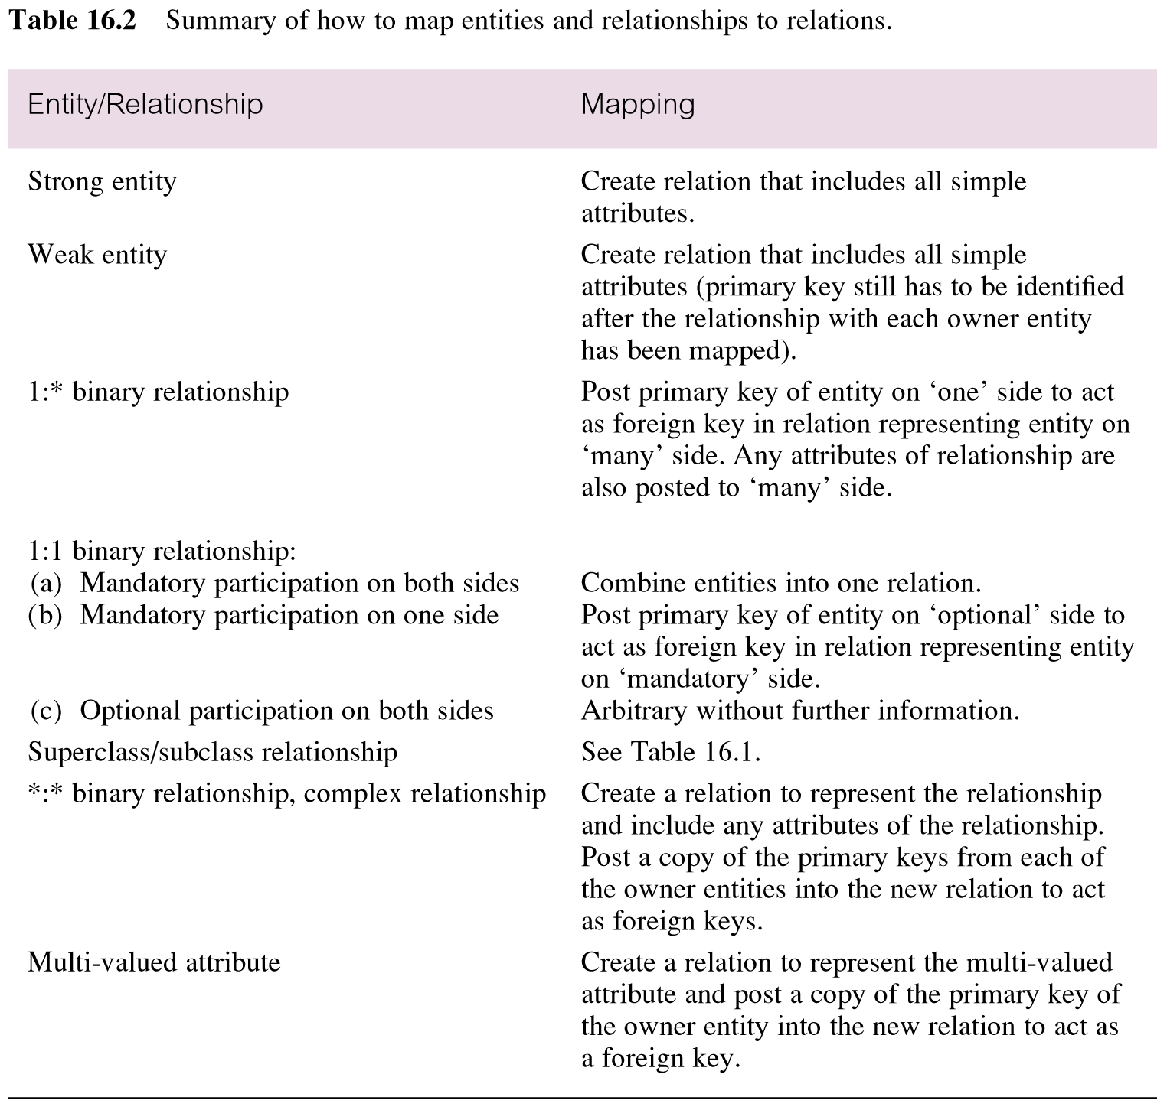
Summary of how to map entities and relationships to relations
Pearson Education © 2009

Slide 20
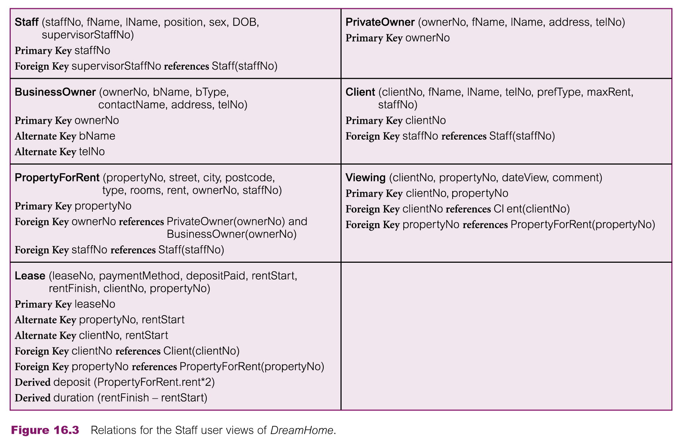
Relations for the Staff user views of DreamHome
Pearson Education © 2009

Slide 21
Step 2.2 Validate relations using normalization
To validate the relations in the logical data model using normalization.
Pearson Education © 2009

Slide 22
Step 2.3 Validate relations against user transactions
To ensure that the relations in the logical data model support the required transactions.
Pearson Education © 2009

Slide 23
Step 2.4 Check integrity constraints
To check integrity constraints are represented in the logical data model. This includes identifying:
Required data
Attribute domain constraints
Multiplicity
Entity integrity
Referential integrity
General constraints
Pearson Education © 2009

Slide 24
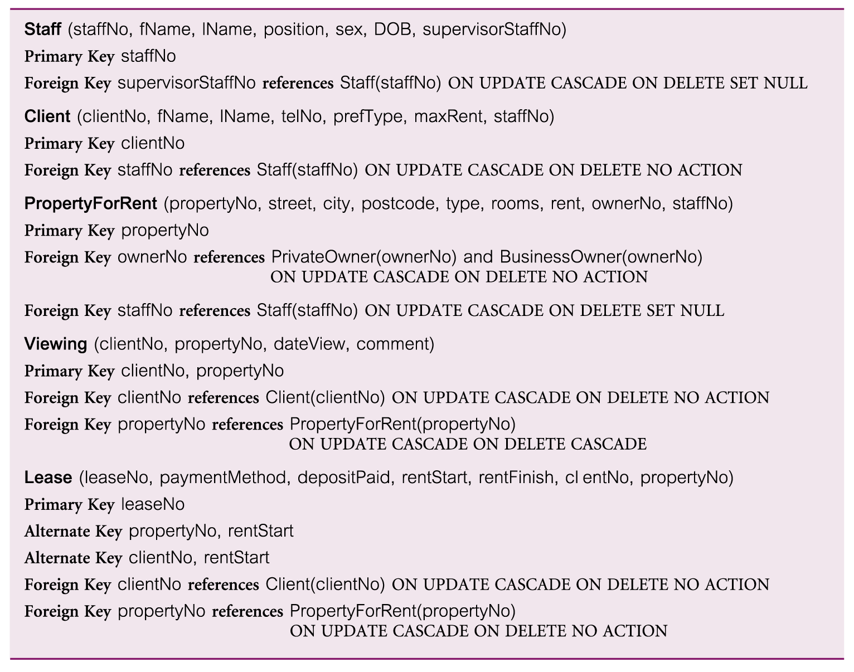
Referential integrity constraints for relations in Staff user views of DreamHome
Pearson Education © 2009

Slide 25
Step 2.5 Review logical data model with user
To review the logical data model with the users to ensure that they consider the model to be a true representation of the data requirements of the enterprise.
Pearson Education © 2009

Slide 26
Step 2.6 Merge logical data models into global Model (optional step)
To merge logical data models into a single global logical data model that represents all user views of a database.
Pearson Education © 2009

Slide 27
Step 2.6.1 Merge local logical data models into global model
To merge local logical data model into a single global logical data model.
This activities in this step include:
Step 2.6.1 Merge local logical data models into global model
Step 2.6.2 Validate global logical data model
Step 2.6.3 Review global logical data model with users.
Pearson Education © 2009

Slide 28
Step 2.6.1 Merge logical data models into a global model
Tasks typically includes:
(1) Review the names and contents of entities/relations and their candidate keys.
(2) Review the names and contents of relationships/foreign keys.
(3) Merge entities/relations from the local data models
(4) Include (without merging) entities/relations unique to each local data model
(5) Merge relationships/foreign keys from the local data models.
(6) Include (without merging) relationships/foreign keys unique to each local data model.
(7) Check for missing entities/relations and relationships/foreign keys.
(8) Check foreign keys.
(9) Check Integrity Constraints.
(10) Draw the global ER/relation diagram
(11) Update the documentation.
Pearson Education © 2009

Slide 29
Step 2.6.2 Validate global logical data model
To validate the relations created from the global logical data model using the technique of normalization and to ensure they support the required transactions, if necessary.
Pearson Education © 2009

Slide 30
Step 2.6.3 Review global logical data model with users
To review the global logical data model with the users to ensure that they consider the model to be a true representation of the data requirements of an enterprise.
Pearson Education © 2009

Slide 31
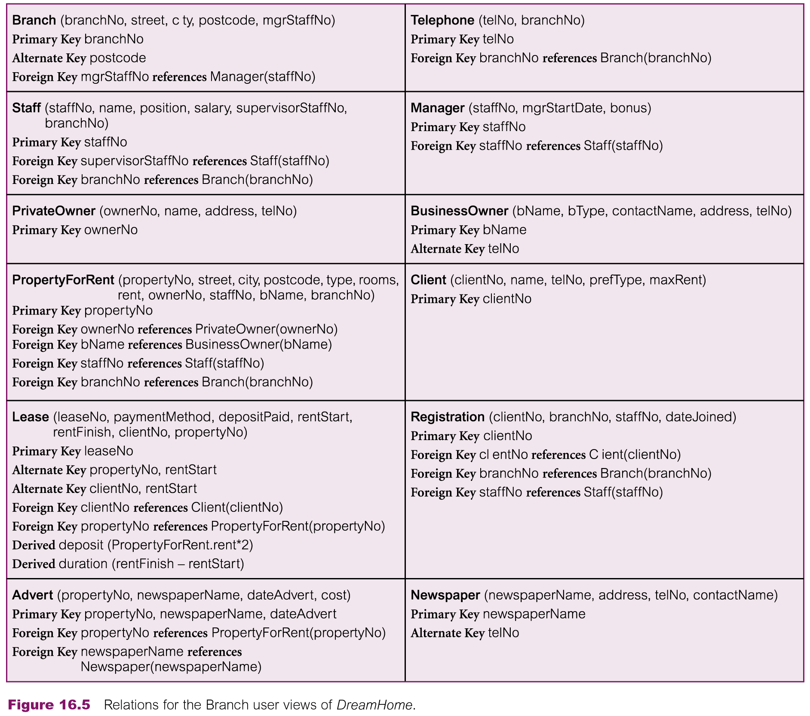
Relations for the Branch user views of DreamHome
Pearson Education © 2009

Slide 32
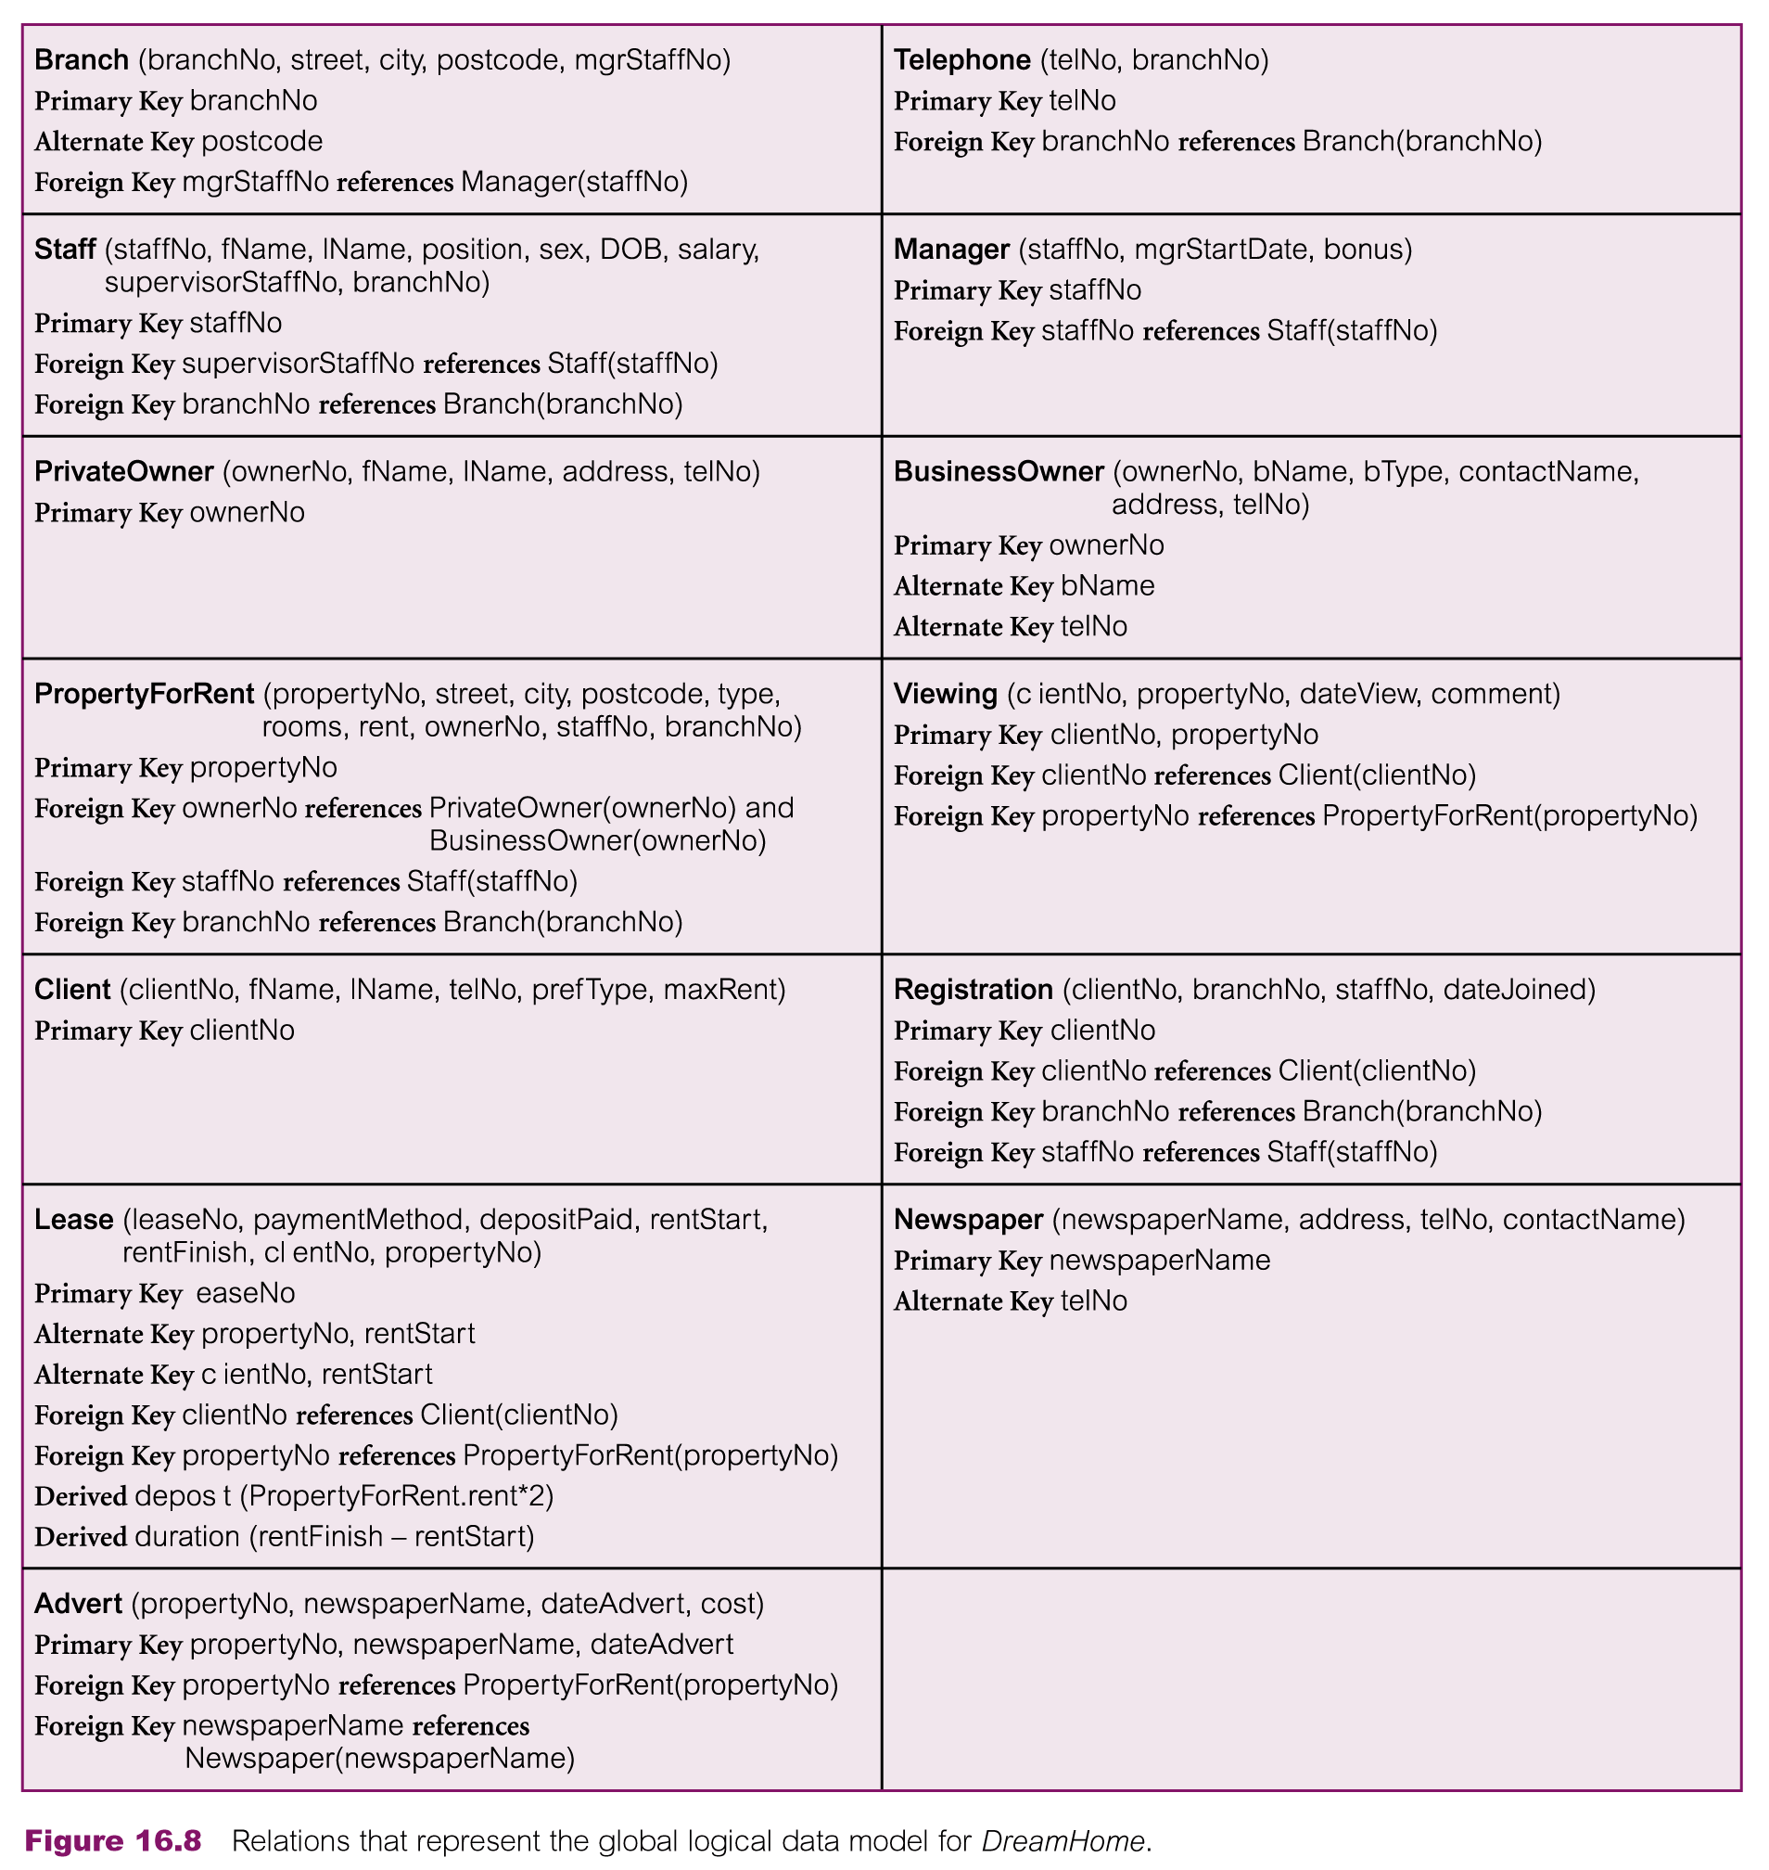
Relations that represent the global logical data model for DreamHome
Pearson Education © 2009

Slide 33
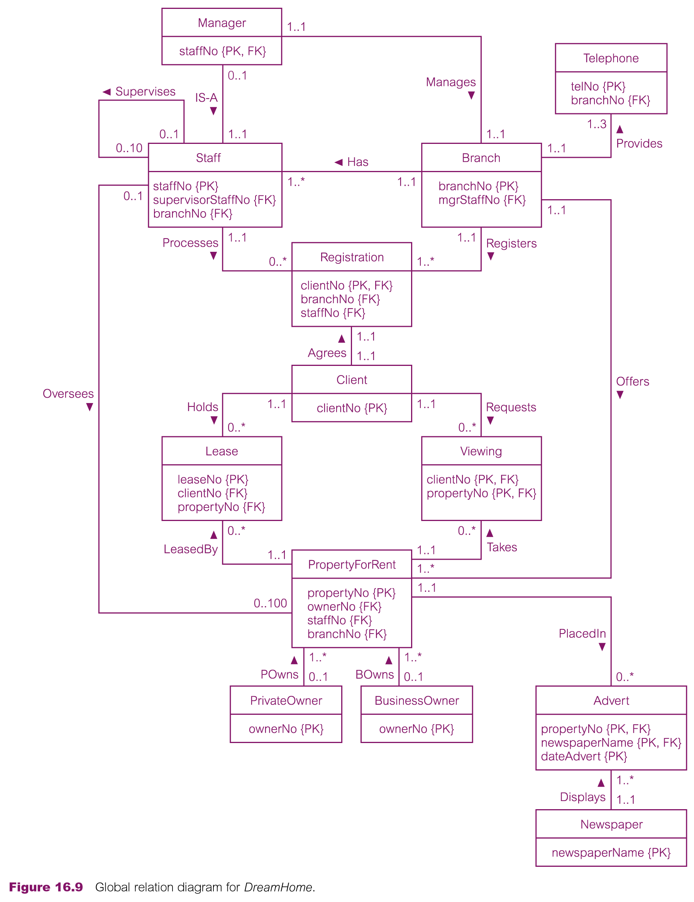
Global relation diagram for DreamHome
Pearson Education © 2009

